Slide 1
Dynamic Multi-agents Secured Collaboration Infrastructure Architecture
An architectural framework for dynamic multi-agent collaboration from an infrastructure perspective, enabling secure and efficient agent interactions at scale.
draft-li-dmsc-inf-architecture
Xueting Li, Aijun Wang
China Telecom

Slide 2













Introduction: Evolution of Intelligent Agents
Early Agents
Connected Agents
Autonomous Agents
Distributed Ecosystems
Embedded within isolated systems, performing narrowly defined tasks
Interactions mediated by application logic, limited in scope
Perceiving changes, making decisions based on local information
Dynamic systems spanning devices, networks, and application platforms
Key Evolution Impacts
Dynamic Collaboration
Expanded Scope
Frequent changes in agent population, roles, and interaction patterns
Interactions spanning devices, networks, and application platforms
New Network Requirements
Adaptive Infrastructure
Scalable, interoperable networking support for agent collaboration
Network must actively participate in agent collaboration
DMSC WORKING GROUP

Slide 3










Network Requirements for Agent Collaboration
Agent interactions introduce new requirements for network infrastructures, moving beyond passive connectivity to active support for collaboration.
Agent Identity Management
Capability-aware Communication
Scalable Discovery
Discovery across heterogeneous platforms, adapting to dynamic agent populations.
Network-visible agent identifiers decoupled from location, enabling consistent recognition across functions.
Communication based on agent capabilities and roles, supporting dynamic role assignment.
Cross-domain Collaboration
Adaptive Routing
Support for collaboration across domains with policy and trust constraints.
Routing decisions considering agent capabilities and collaboration context.
Key insight: Future networks must support dynamic multi-agent collaboration by elevating key collaboration functions into the network infrastructure.
DMSC WORKING GROUP

Slide 4

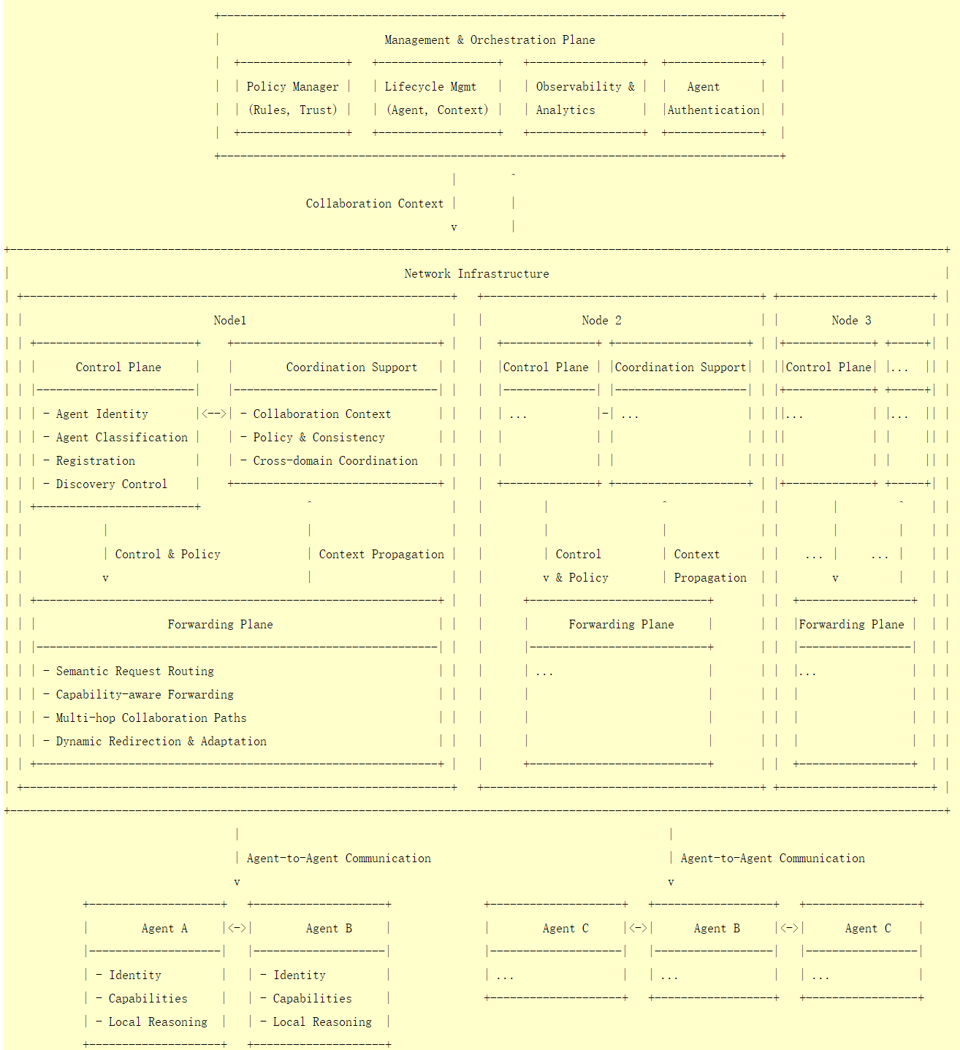












DMSC Infrastructure Architecture Overview
The DMSC architecture organizes network infrastructure into three logical layers:
Management Plane
Governs policies and trust
Manages lifecycle and authentication
Control Plane
Manages agent identity and discovery
Handles collaboration context
Forwarding Plane
Supports semantic-aware routing
Enables data forwarding for agent interactions
Coordination Support Functions
Key Architecture Principles:
Provides higher-level abstractions that bridge agent collaboration and network operations.
Preserves agent autonomy and task-level reasoning
Network provides generic support without executing agent logic
DMSC WORKING GROUP

Slide 5












Core Infrastructure Functions
Agent Identification
Infrastructure-Level Discovery
Semantic Request Routing
Network-visible identifiers decoupled from location
Discovery queries based on capabilities and policies
Requests in terms of agent capabilities and roles
Classification based on capabilities and roles
Supports intra-domain and inter-domain contexts
Dynamic direction to agents capable of fulfilling roles
Context Propagation
Operational Visibility
Key Benefit
Maintains shared context across collaboration
Observability at the collaboration level
Enabling dynamic multi-agent collaboration while preserving agent autonomy and providing a common foundation for protocols and security specifications.
Context attached to control-plane interactions
Observable entities: agent interactions
DMSC WORKING GROUP

Slide 6









Conclusion and Future Work
Key Conclusions
Future Work
Infrastructure-Centric Approach
Protocol Development
Network infrastructure provides agent-aware control and semantic-aware forwarding as first-class capabilities
Detailed protocol designs to support the architectural framework
Clear Architectural Boundaries
Security Architecture
Separates agent intelligence from network responsibility, enabling independent evolution
Security mechanisms to protect agent collaboration
Foundation for Evolution
Deployment Specifications
Provides common foundation for protocol, security, and deployment specifications
Implementation guidelines for practical deployments
DMSC WORKING GROUP

